Slide 1

A Project-II Presentation
on
clini-C-are
A Clinical Automation System
Internal Guide:
Prof. Sachin Solanki
External Guide:
Mr. Manjunath Awathi
Presented By:
Tanu Dhoot
(EN16CS30277)

Slide 2

The International Business Machines Corporation is an American Multinational Technology Company headquartered in Armonk, New York, with operations in over 170 countries.
IBM produces and sells computer hardware, middleware and software, and provides hosting and consulting services in areas ranging from mainframe computers to nanotechnology.
IBM is a leading cloud platform and cognitive solutions company.
IBM is the largest technology and consulting employer in the world, with more than 350,000 employees serving clients in 170 countries.

Slide 3
Technologies in IBM
Analytics
Cloud Computing
Mobile Technology
Artificial Intelligence
IT Infrastructure
Security
Blockchain
IT Management
Software Development

Slide 4
Training Under IBM
• Data Structures
• Microsoft SQL Server
• Front-End Technologies
o HTML
o CSS
o JavaScript
o Bootstrap
• .NET Framework
• C# Fundamentals
• WPF
• WCF
• LINQ Expressions
• ADO.NET
• .NET Entity Framework
• ASP.NET
• ASP.NET MVC Framework
• AJAX

Slide 5
Problem Statement
WHY clini-C-are?
With the discovery of new diseases almost every year, and an increase in the number of patients with regular diseases, there is a requirement of huge growth in the medical sector.
In the current system, the workflow of any Medical Institution utilizes paper. From patient registration to billing, papers are needed.
As the institution grows, it becomes quite difficult to locate all the papers and utilizes a lot of time and energy.
It is also tedious for patients as they have to wait in queues for their appointments, and with no means to contact their physician directly, have to wait for simple queries.
During the time of this epidemic, it is also needed that minimal contact must be maintained.

Slide 6

The Purpose
WHAT is clini-C-are?
The main purpose of clini-C-are is to create a paper-less system for any medical institution and to tie up the medical institution and the patient together.
clini-C-are also aims at making the basic functions of any clinic like requesting appointments, ordering drugs, etc. easy.
Another objective is to save the communication time so that more time can be given to the treatment of patients and their ease.
To provide security to patients’ history that is unachievable through paperwork.

Slide 7
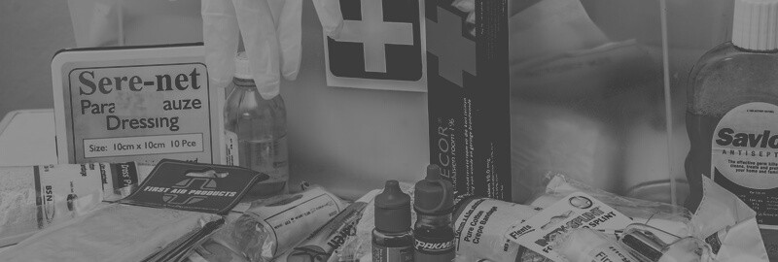






Users of clini-C-are
Guest
Admin
Patient
Physician
Salesperson
Supplier

Slide 8
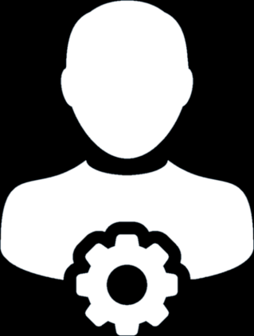

The Implementation
Guest User
1. Can View Drug Inventory
3. Can Request Admin
For Registration
2. Can View Physicians

Slide 9
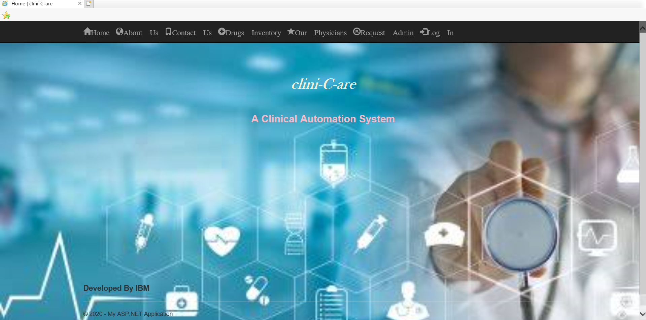
Snapshot of clini-C-are
Home Page of clini-C-are

Slide 10

The Implementation
Admin User
4. View and Block All Registered Users
i.e. Patients, Physicians, Salesperson, and Suppliers
5. View and Delete Drugs
3. Register Users
Edit Personal Details
Change Password

Slide 11
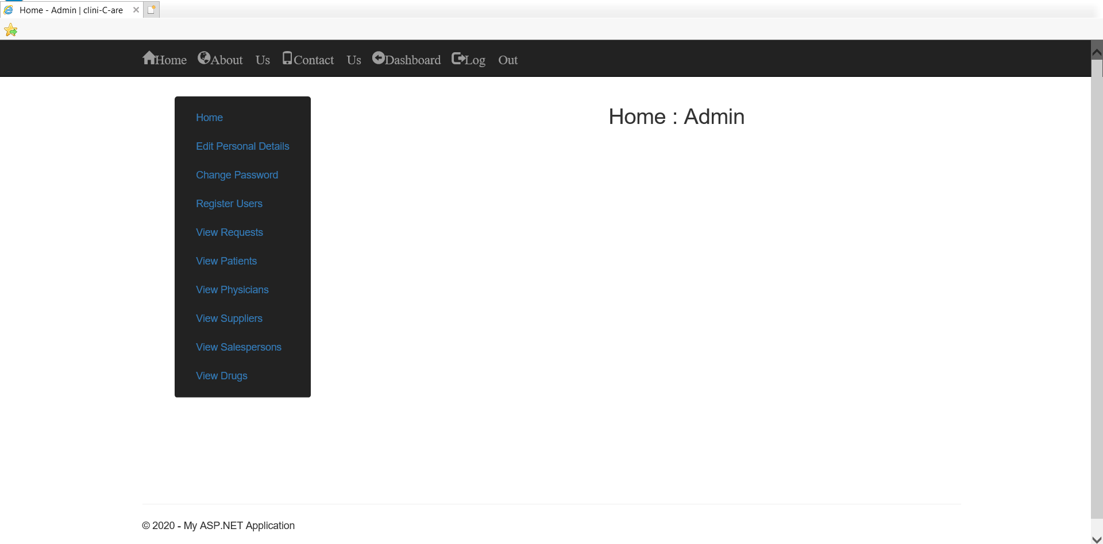
Snapshot of clini-C-are
Home Page of Admin User

Slide 12

The Implementation
Patient User
Edit Personal Details
Change Password
6. Order Drugs
7. View Orders
3. Request Appointment
4. View Appointment
5. Message Physician

Slide 13
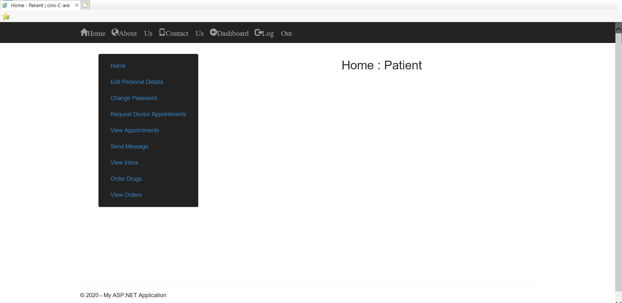
Snapshot of clini-C-are
Home Page of Patient User

Slide 14
The Implementation
Physician User
Edit Personal Details
Change Password
6. Message Salesperson
3. Accept/Reject Appointments
5. Message Patient
4. Update Patients’ History

Slide 15
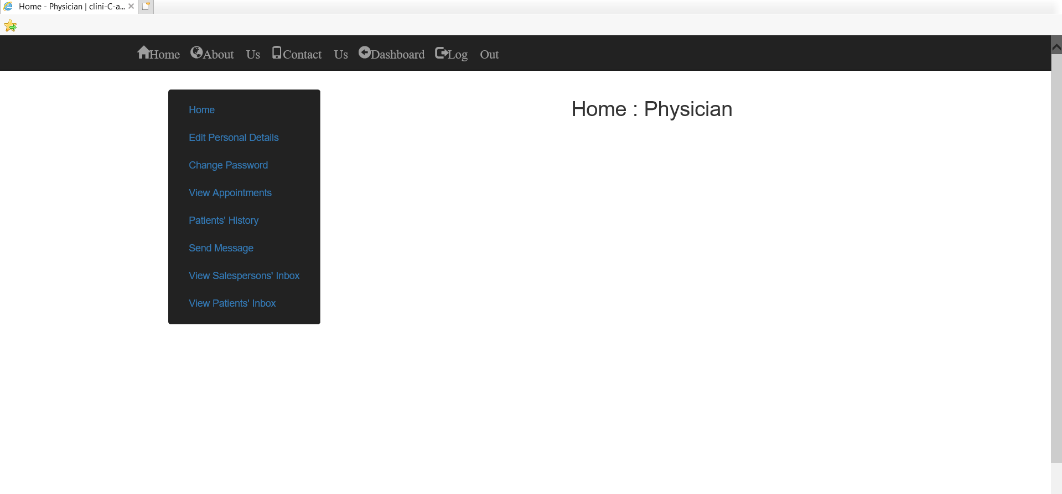
Snapshot of clini-C-are
Home Page of Physician User

Slide 16


The Implementation
Salesperson User
3. Add Drug Details
4. Edit Drug Details
5. Delete Drugs
6. Accept/Reject Raised Orders
7. Place Orders
8. View Placed Orders
9. Message Physician
Edit Personal Details
Change Password
10. Message Supplier

Slide 17
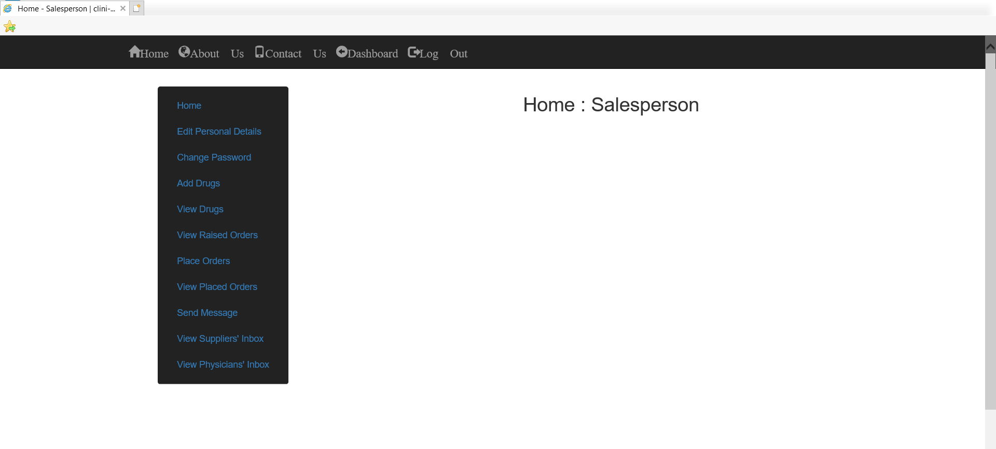
Snapshot of clini-C-are
Home Page of Salesperson User

Slide 18
The Implementation
Supplier User
Edit Personal Details
Change Password
3. Accept/Reject
Raised Orders
4. Message Salesperson

Slide 19
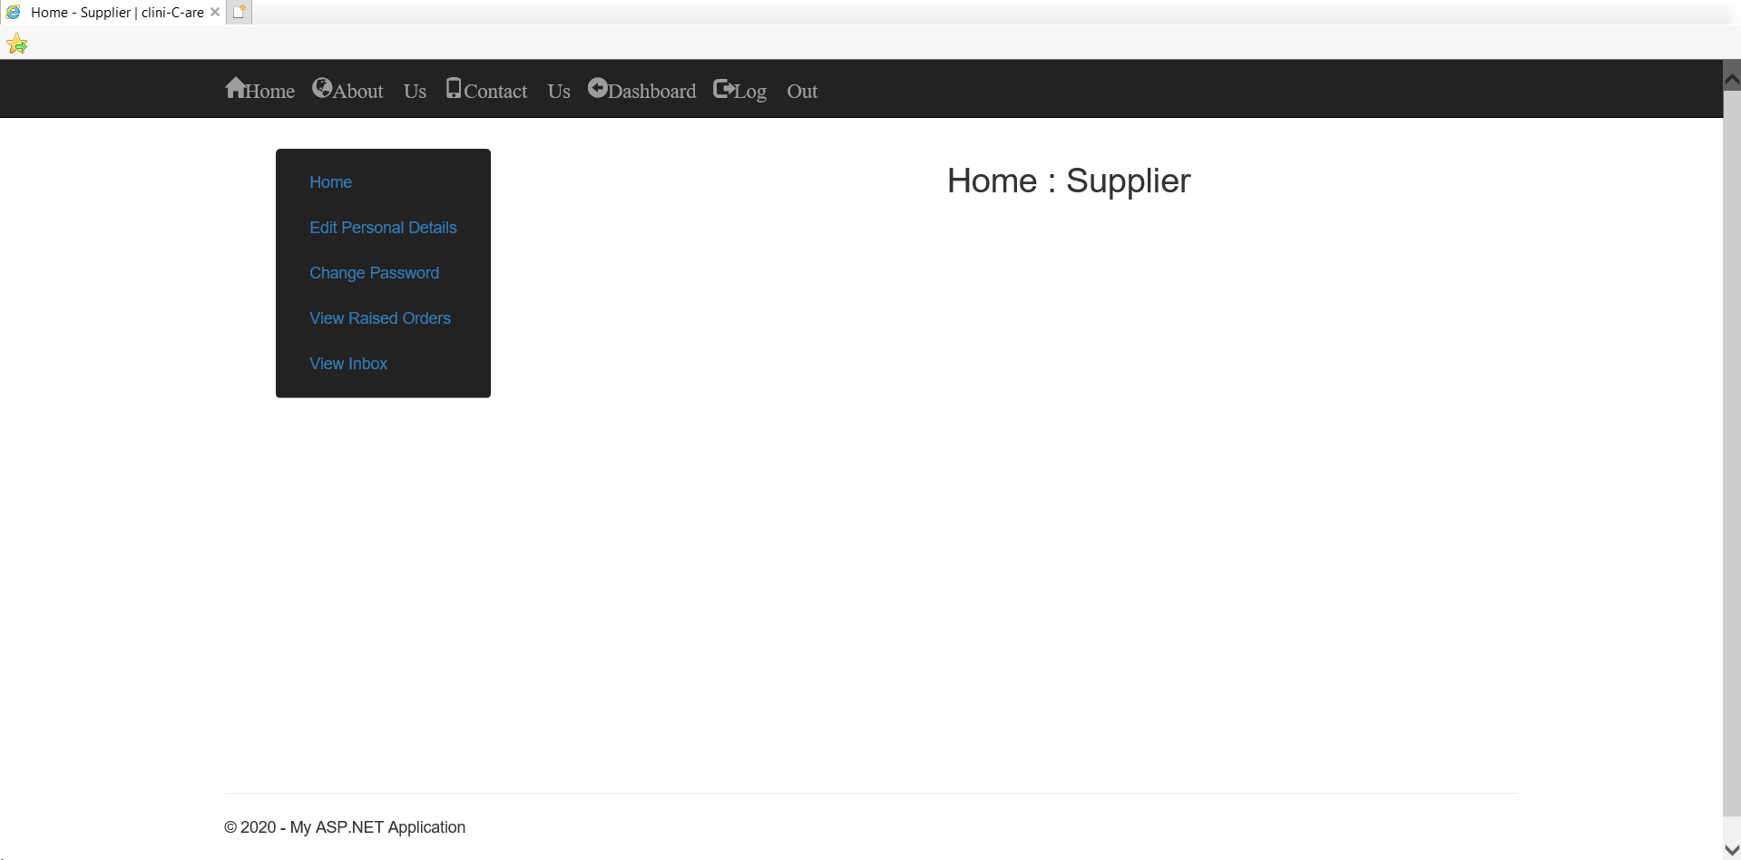
Snapshot of clini-C-are
Home Page of Supplier User

Slide 20

Snapshots

Slide 21
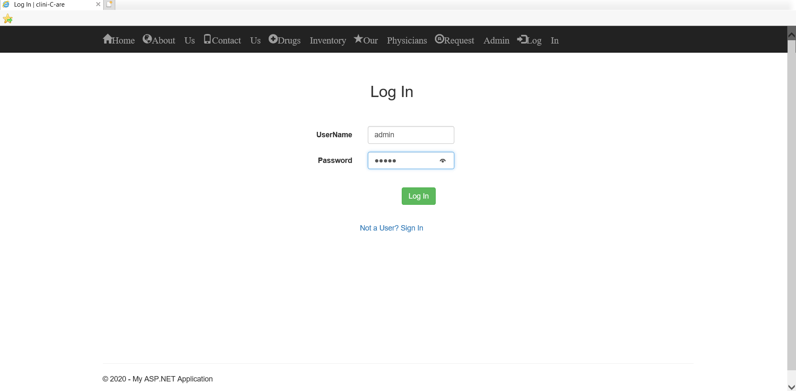
Snapshot of clini-C-are
Log In Page

Slide 22
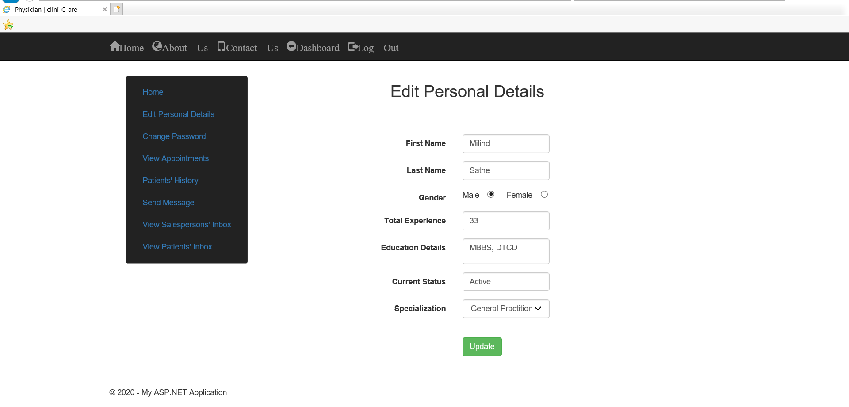
Snapshot of clini-C-are
Edit Personal Details Page

Slide 23
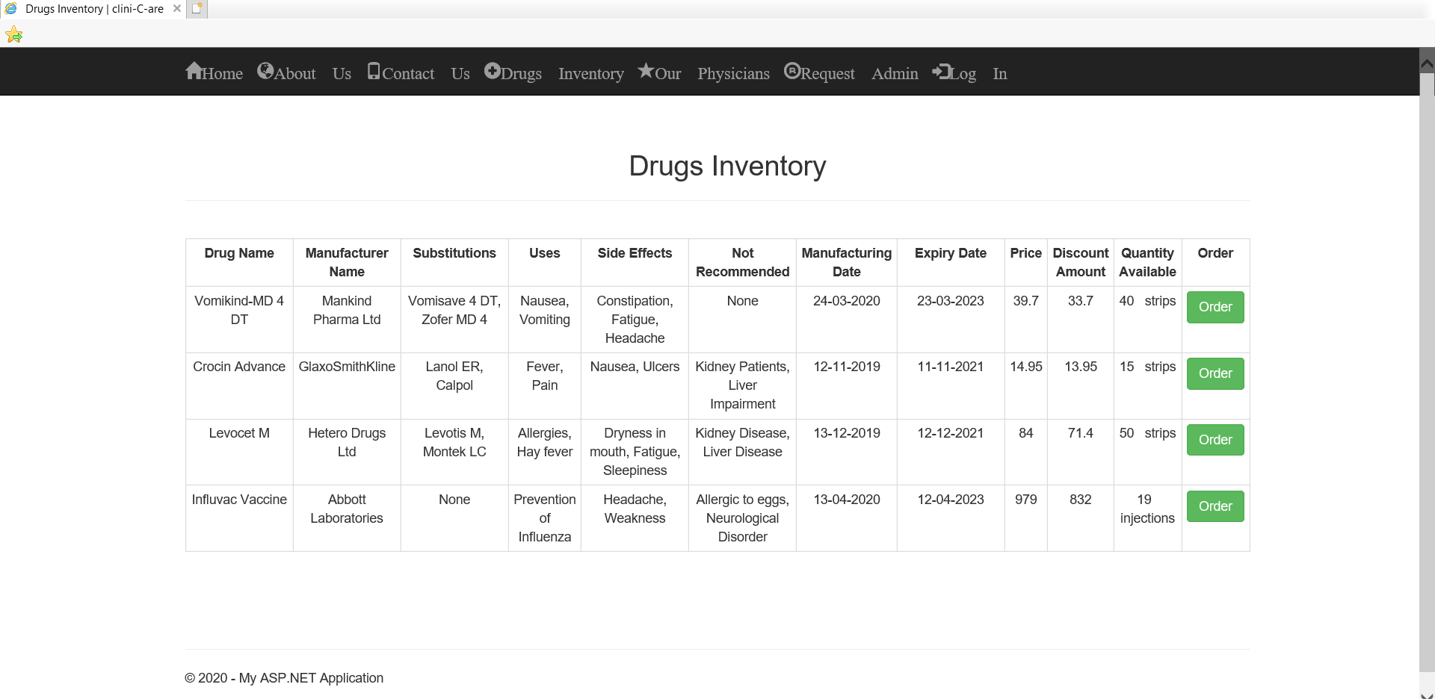
Snapshot of clini-C-are
Drugs Inventory Page

Slide 24
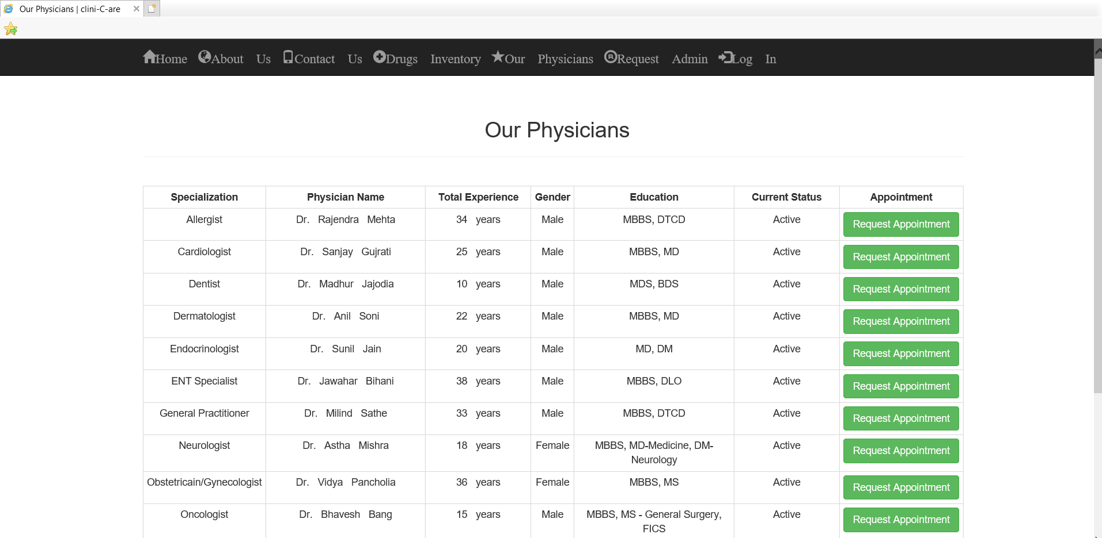
Snapshot of clini-C-are
Our Physicians Page

Slide 25
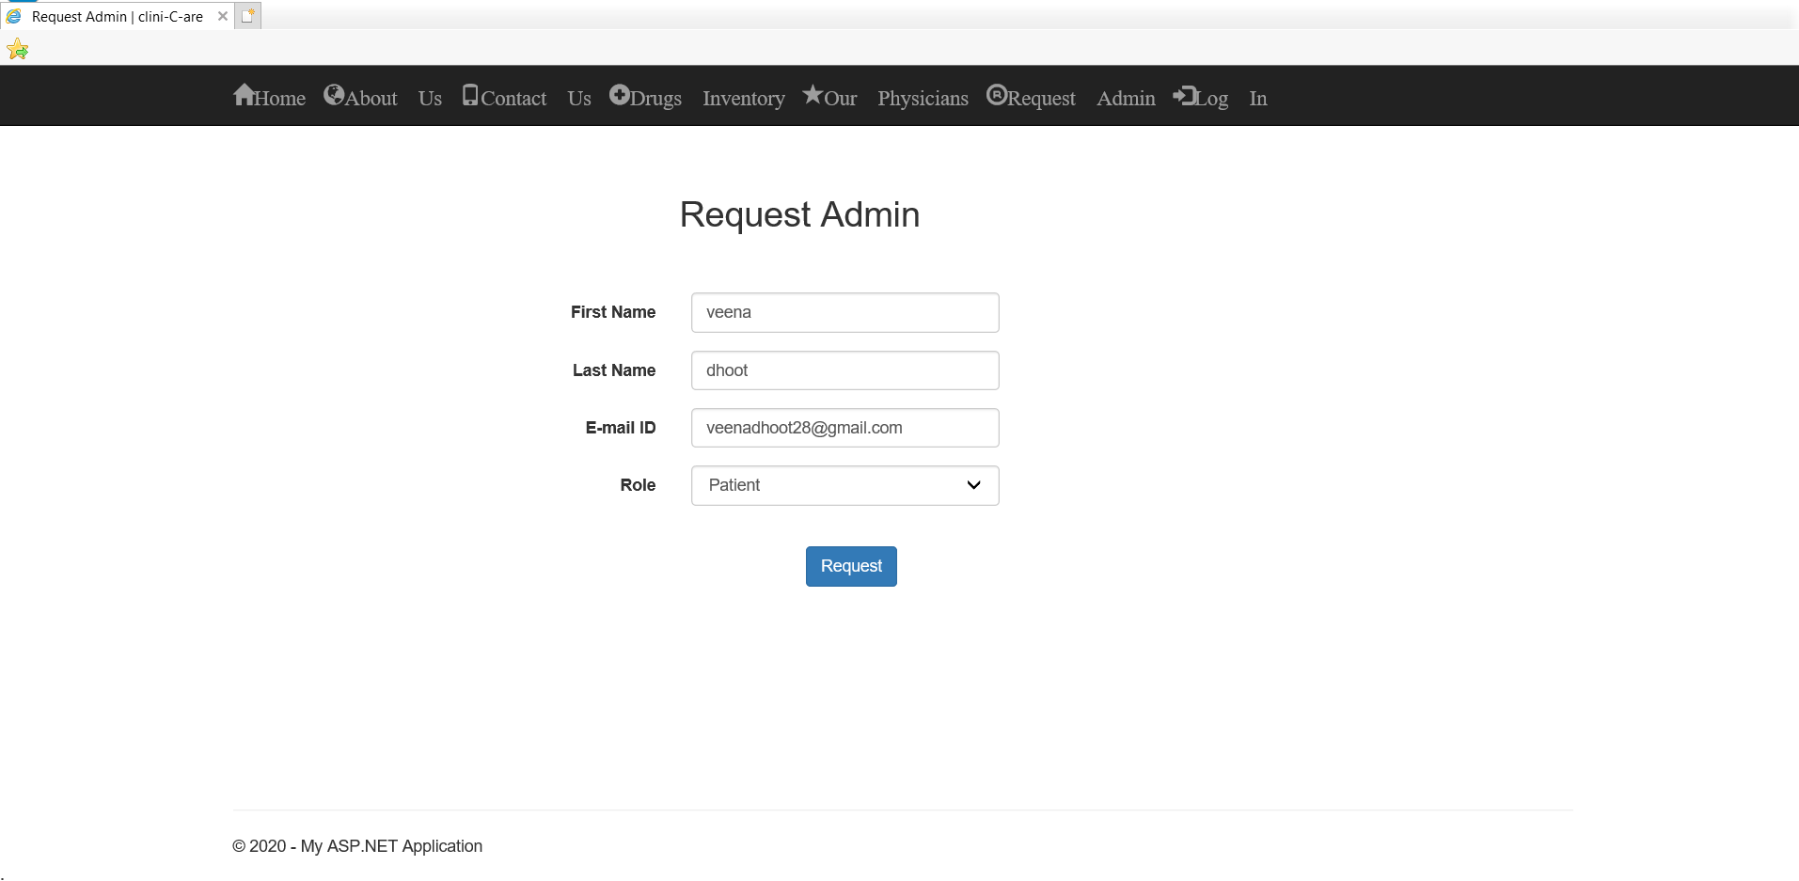
Snapshot of clini-C-are
Request Admin Page

Slide 26
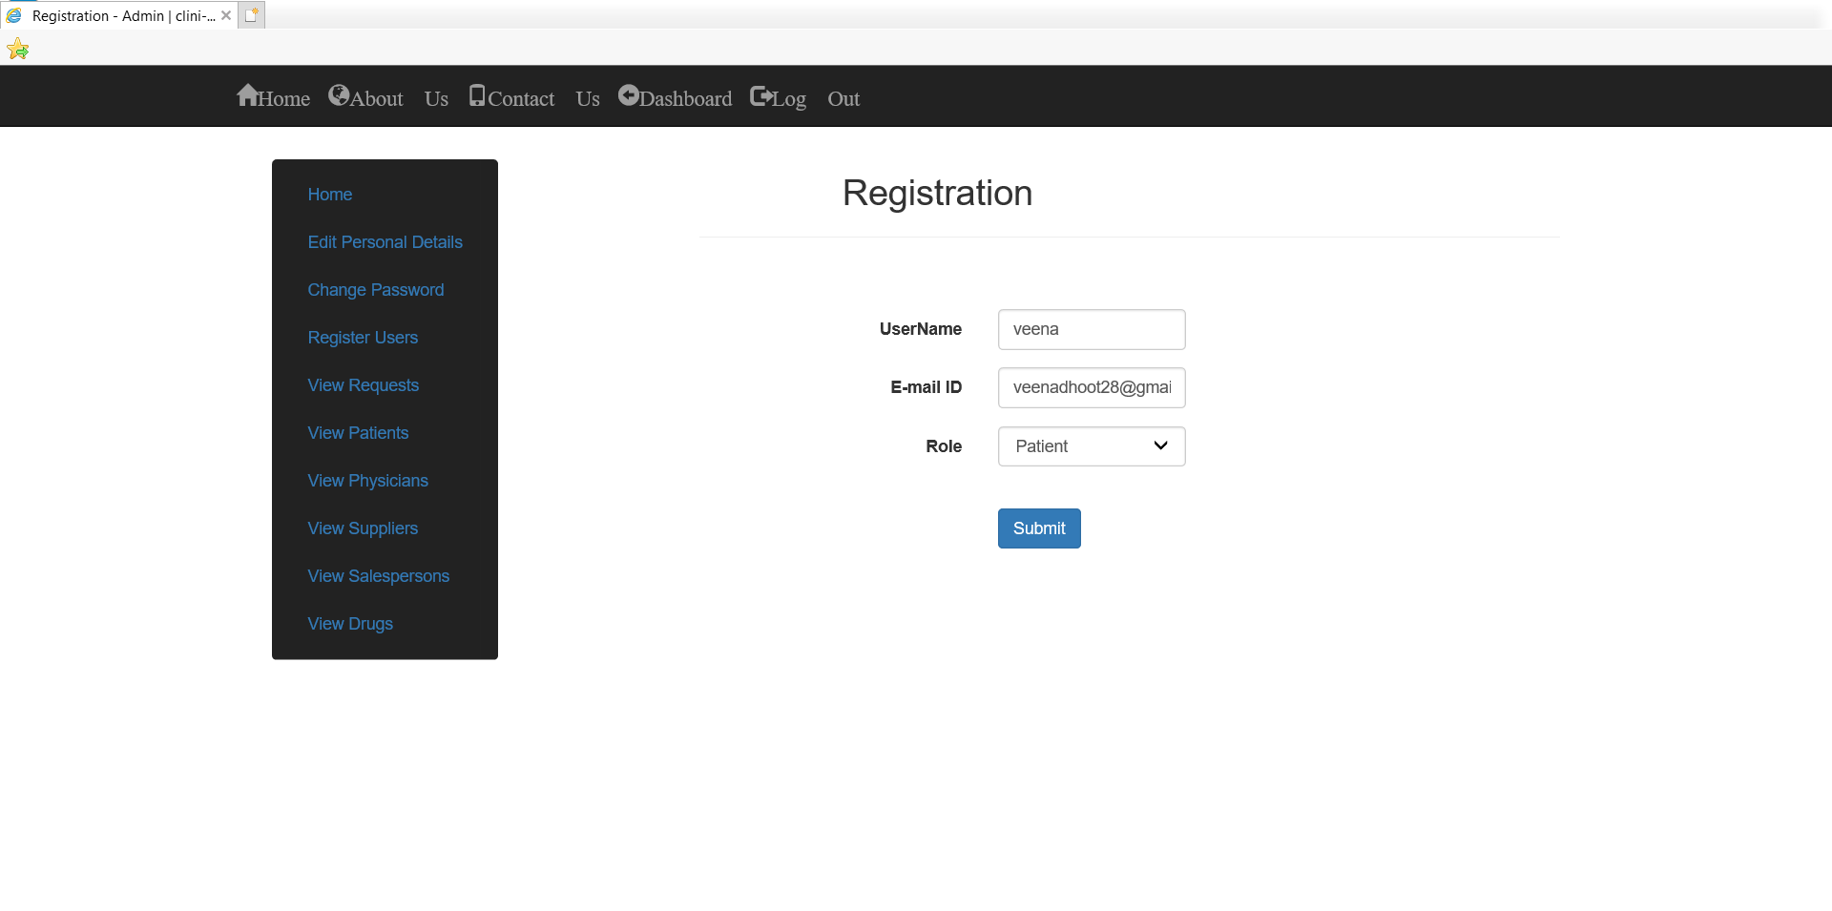
Snapshot of clini-C-are
Registration Page

Slide 27
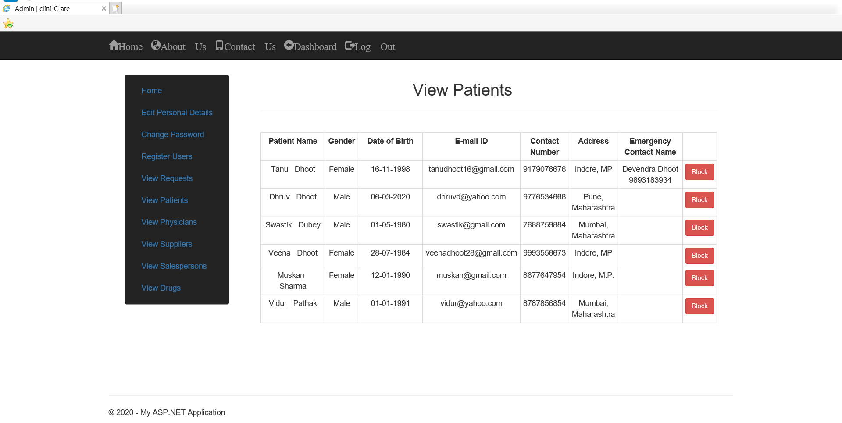
Snapshot of clini-C-are
View User Page – Admin

Slide 28
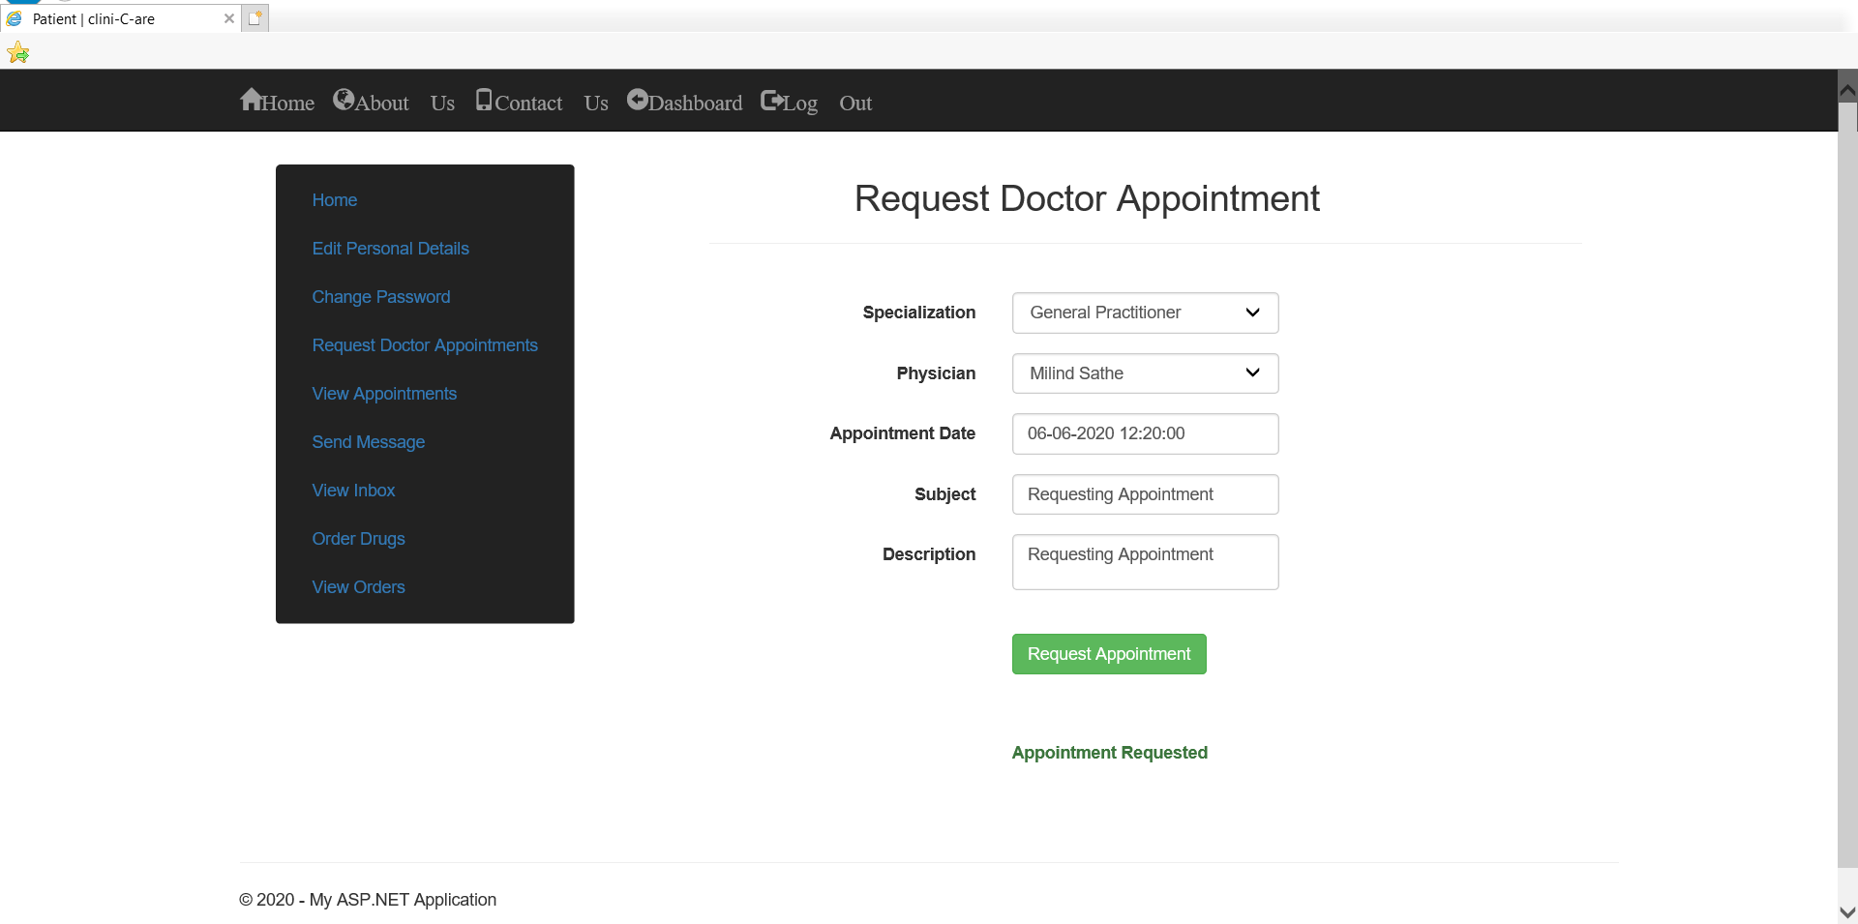
Snapshot of clini-C-are
Request Appointment Page – Patient

Slide 29
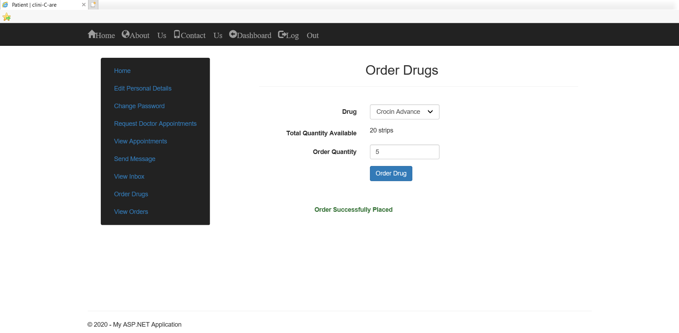
Snapshot of clini-C-are
Order Drugs Page – Patient

Slide 30
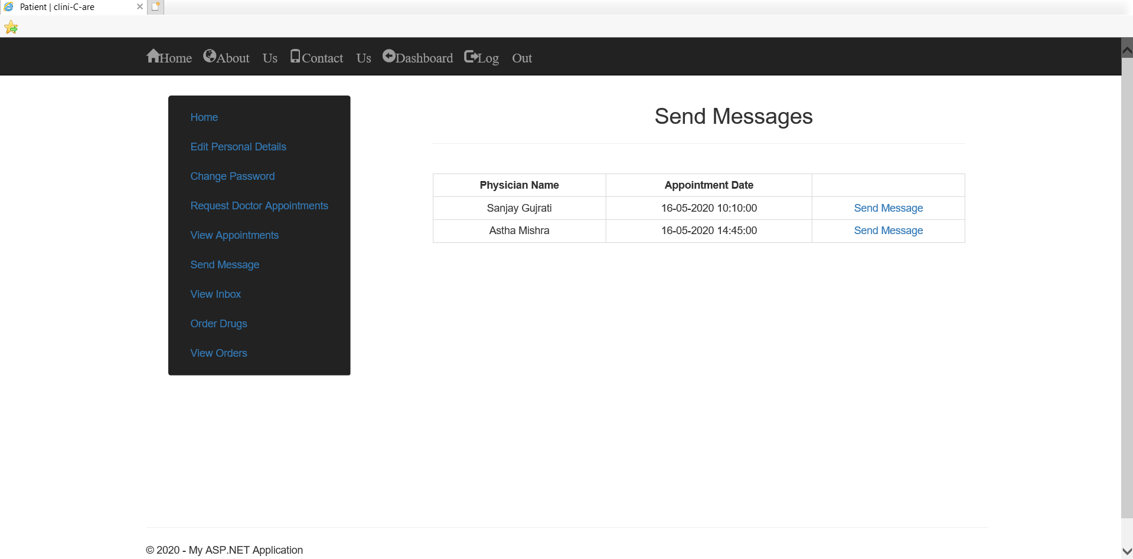
Snapshot of clini-C-are
Send Messages Page – Patient

Slide 31
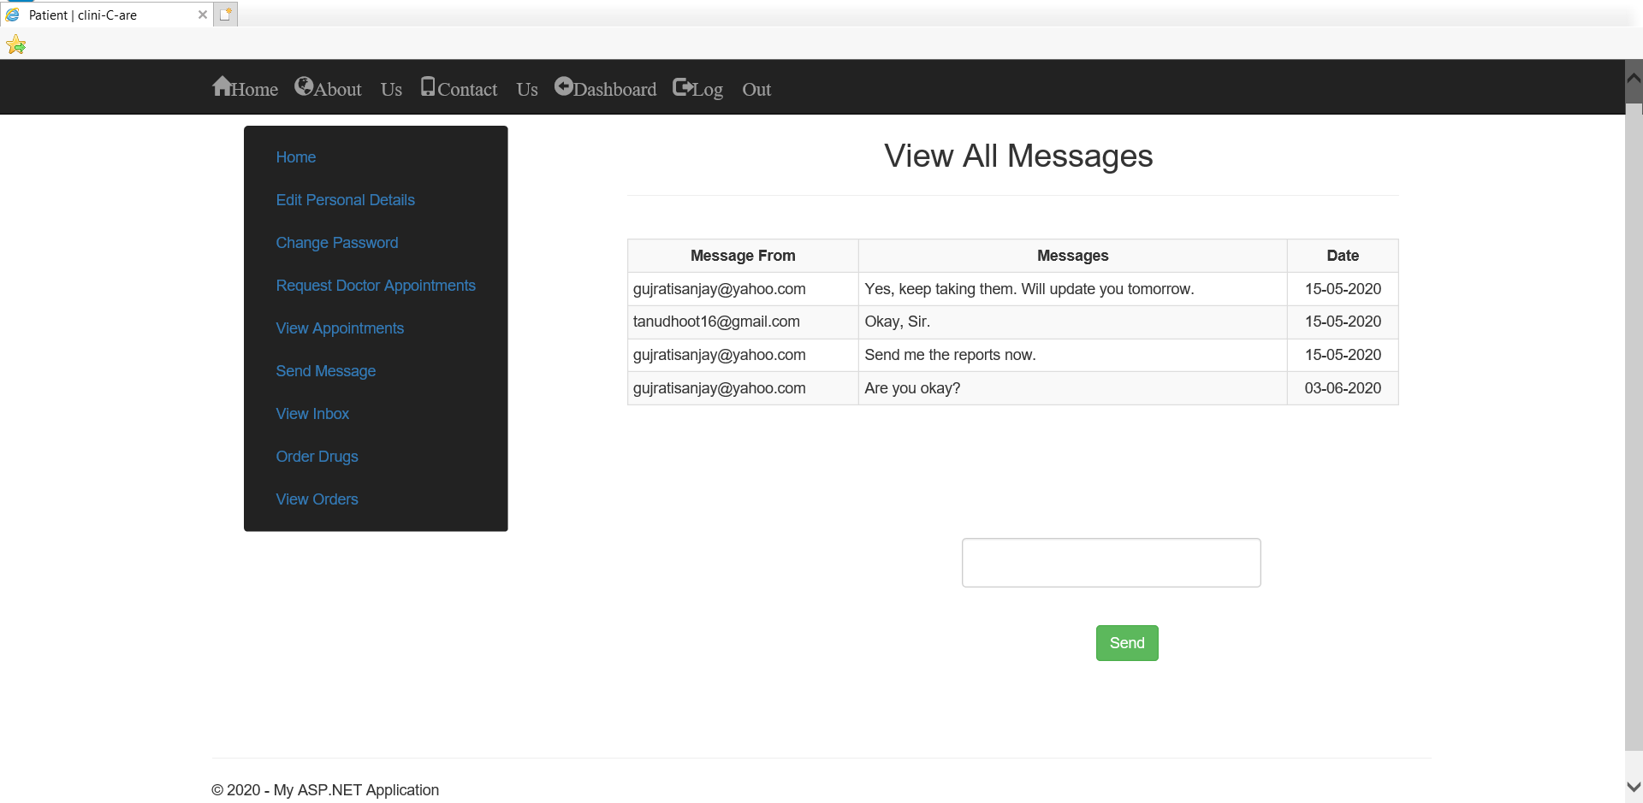
Snapshot of clini-C-are
Inbox – Patient

Slide 32
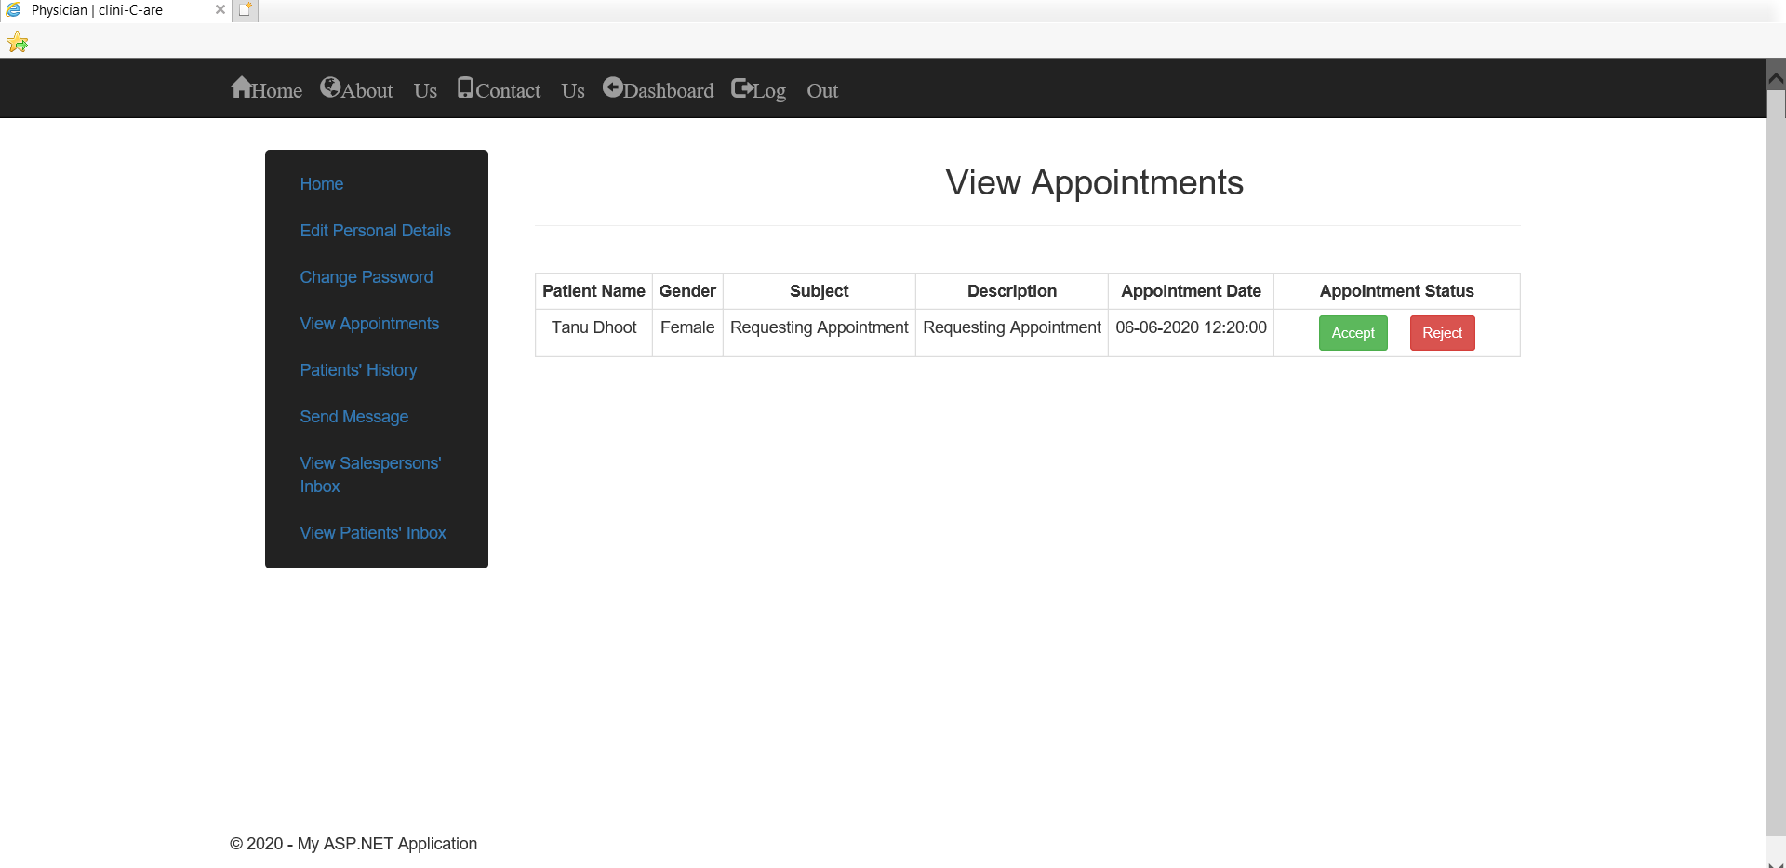
Snapshot of clini-C-are
View Appointments Page – Physician

Slide 33
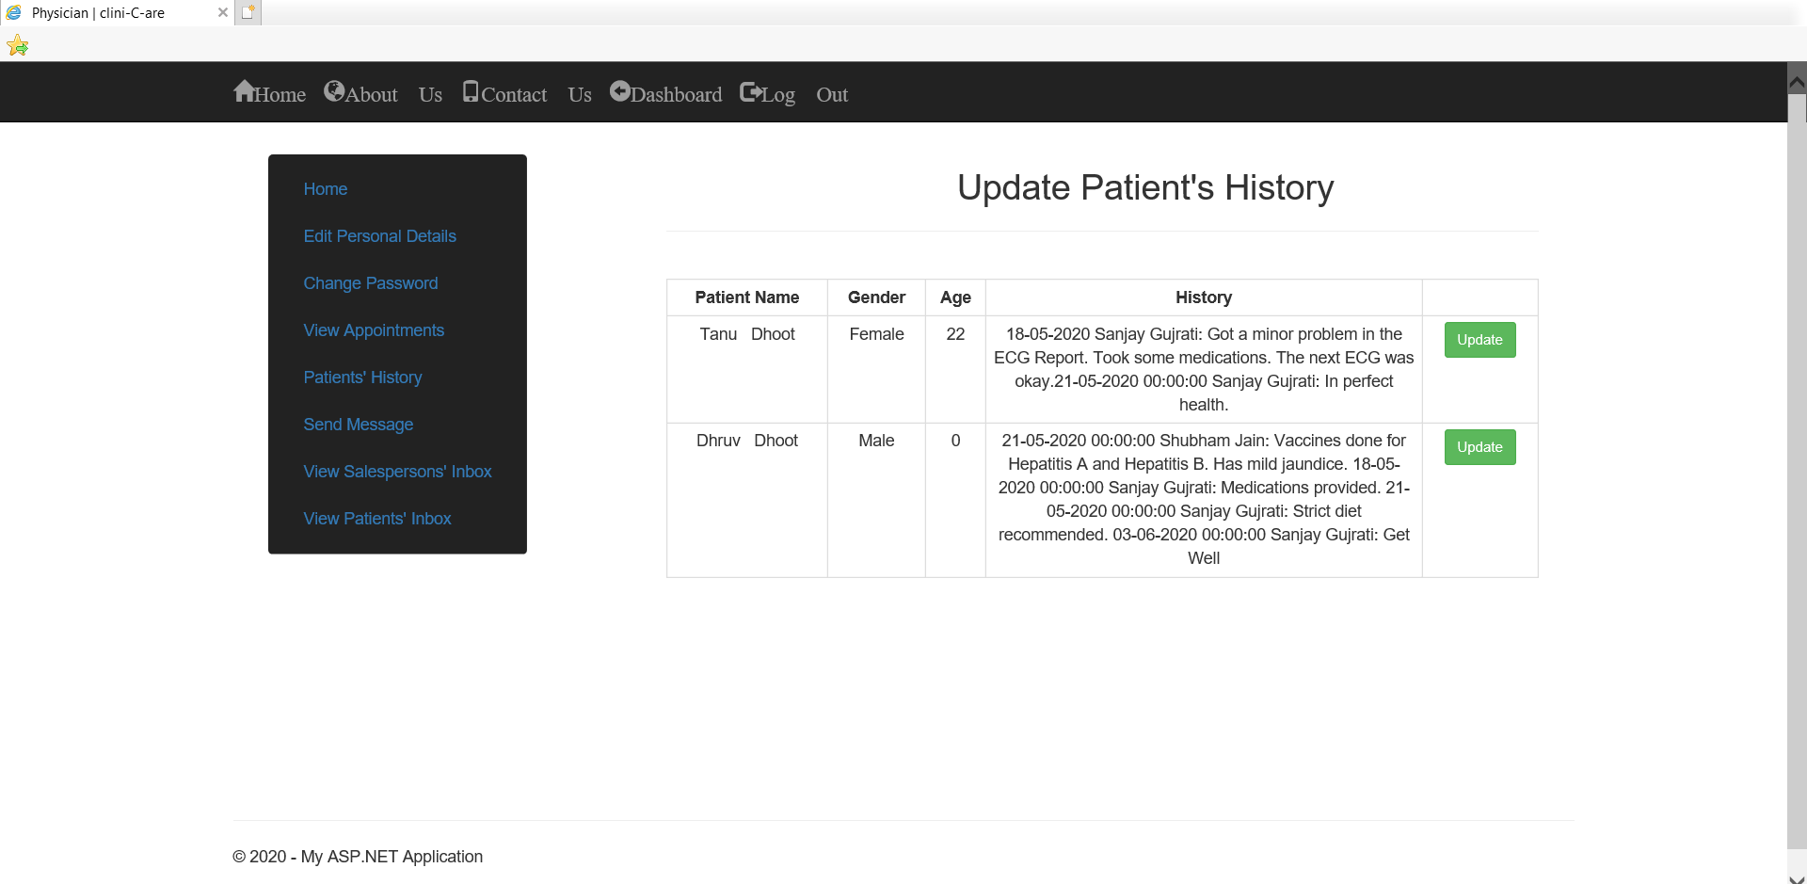
Snapshot of clini-C-are
Update Patient’s History Page – Physician

Slide 34
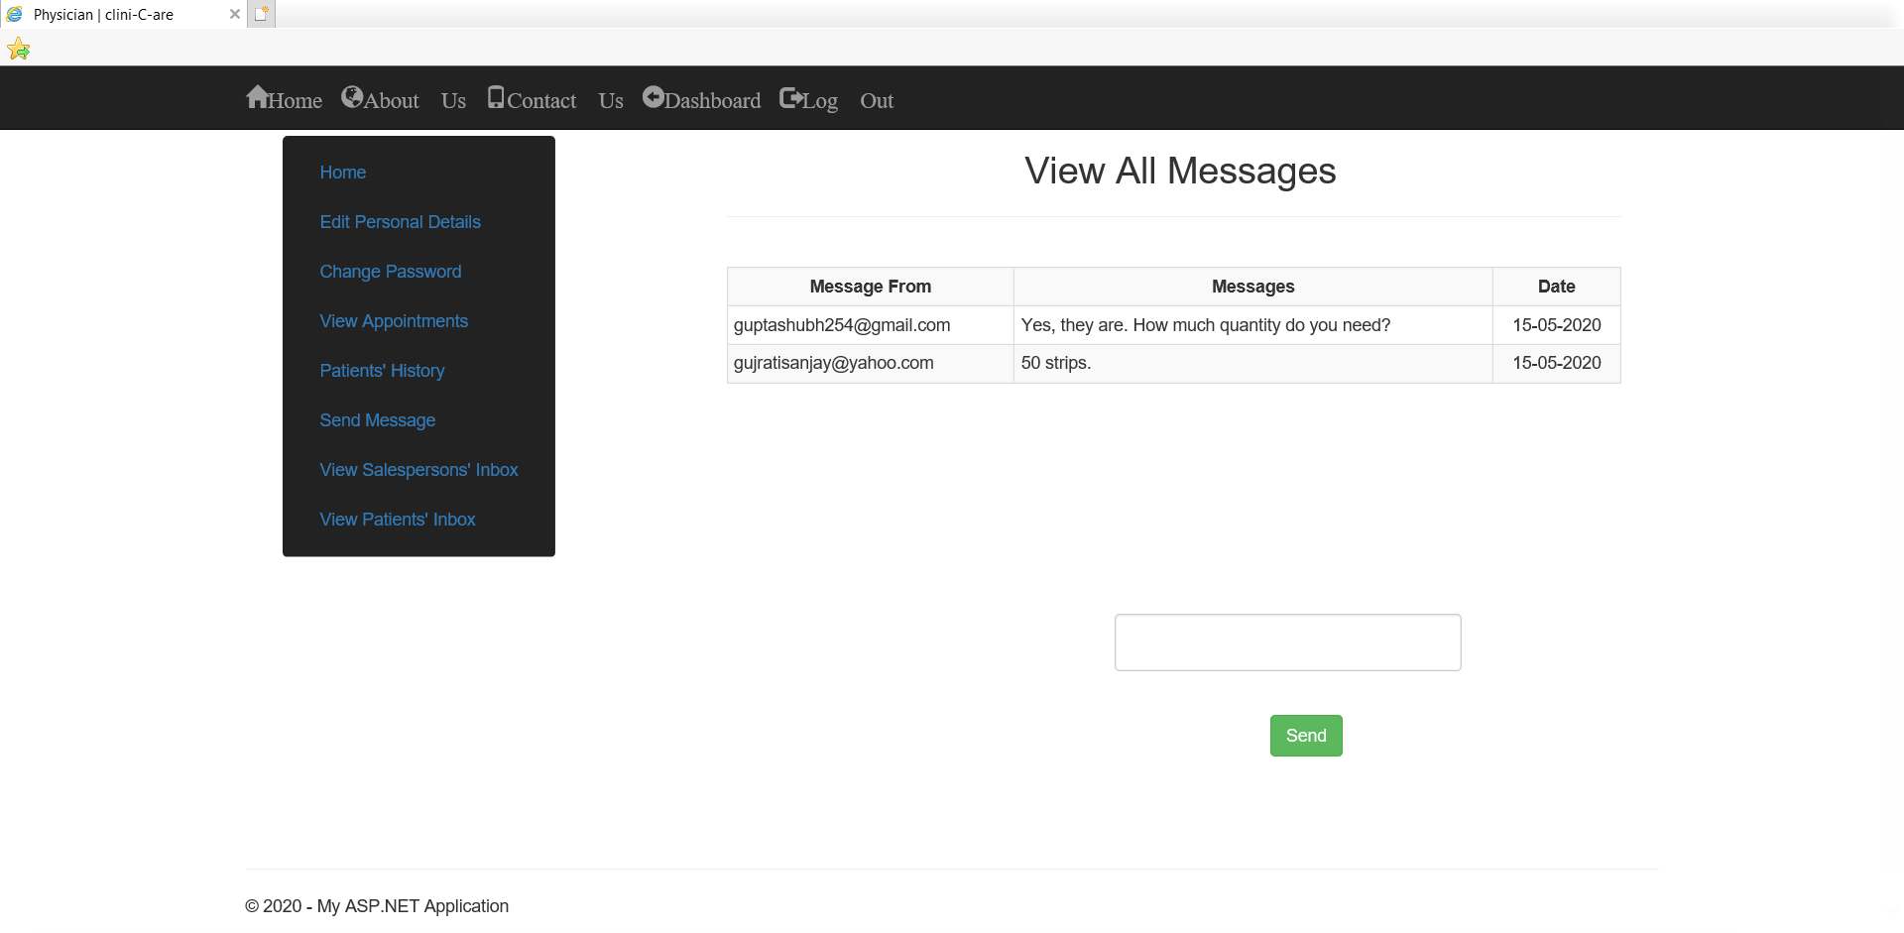
Snapshot of clini-C-are
Salesperson’s Inbox – Physician

Slide 35
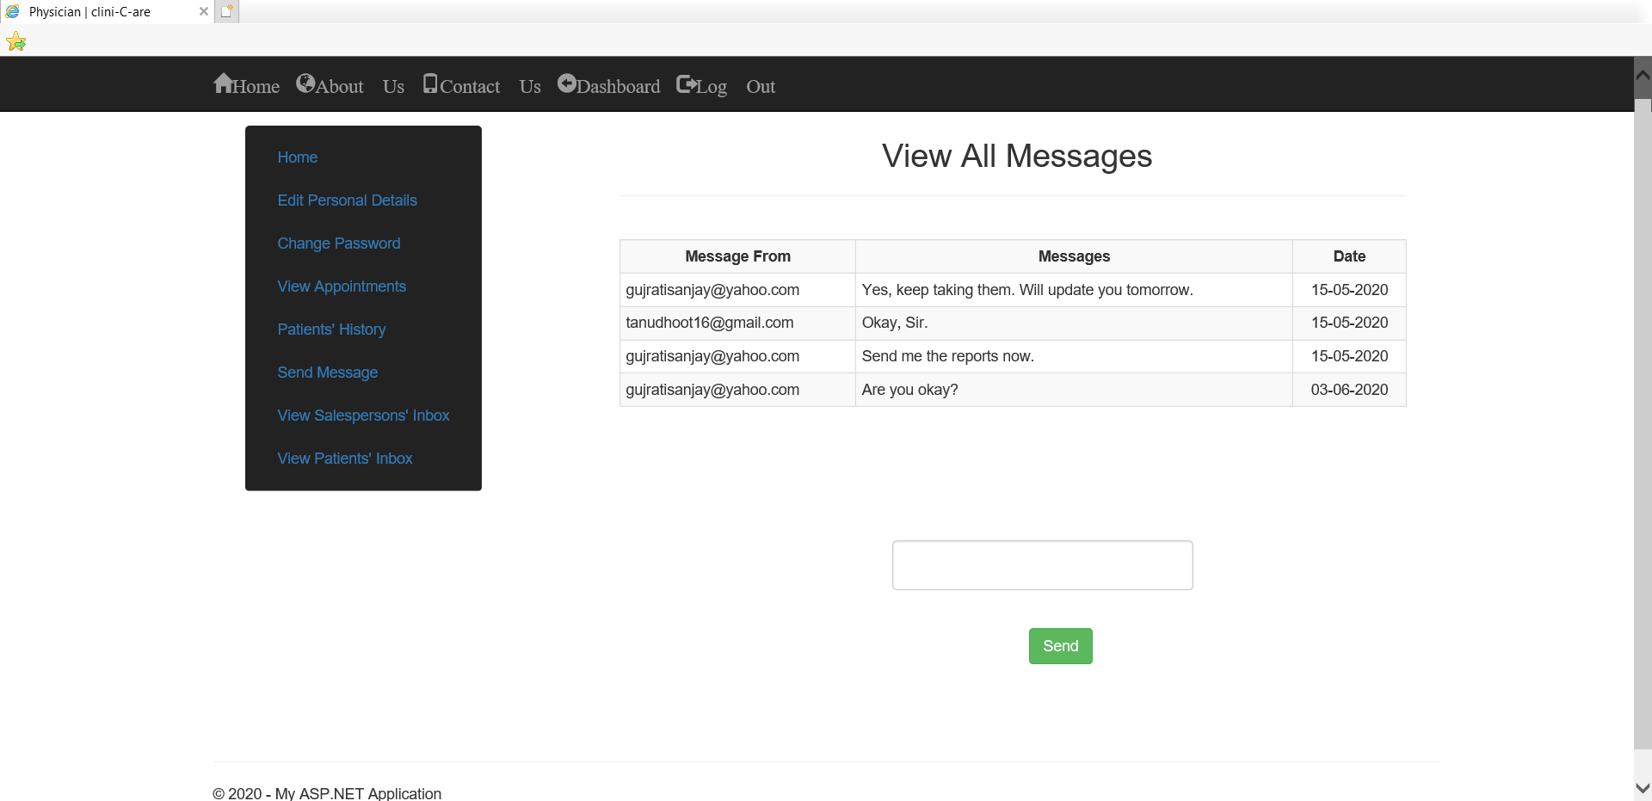
Snapshot of clini-C-are
Patients’ Inbox – Physician

Slide 36
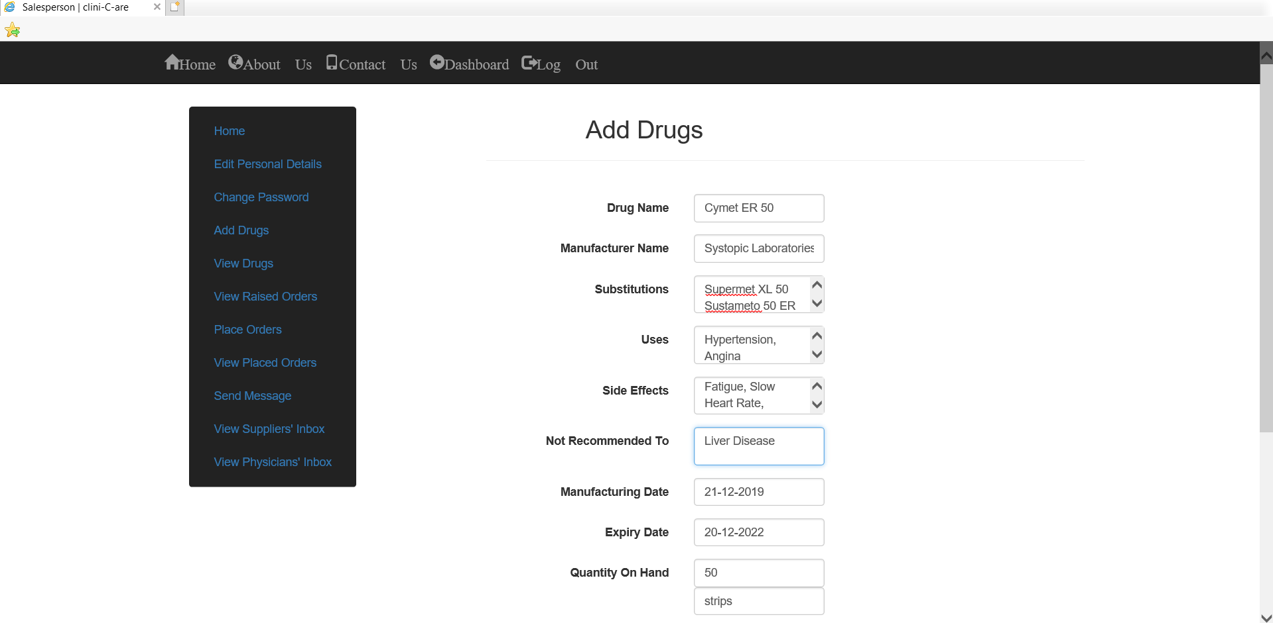
Snapshot of clini-C-are
Add Drugs Page – Salesperson

Slide 37
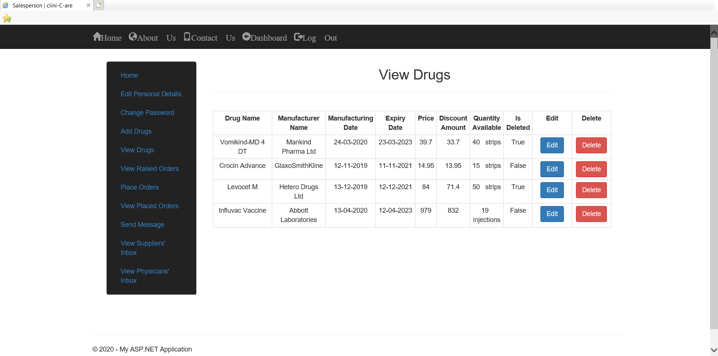
Snapshot of clini-C-are
View Drugs Page – Salesperson

Slide 38
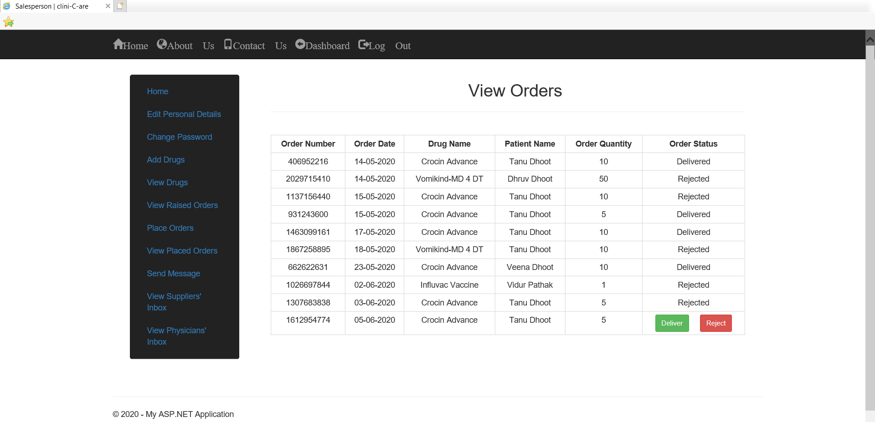
Snapshot of clini-C-are
View Raised Orders Page – Salesperson

Slide 39
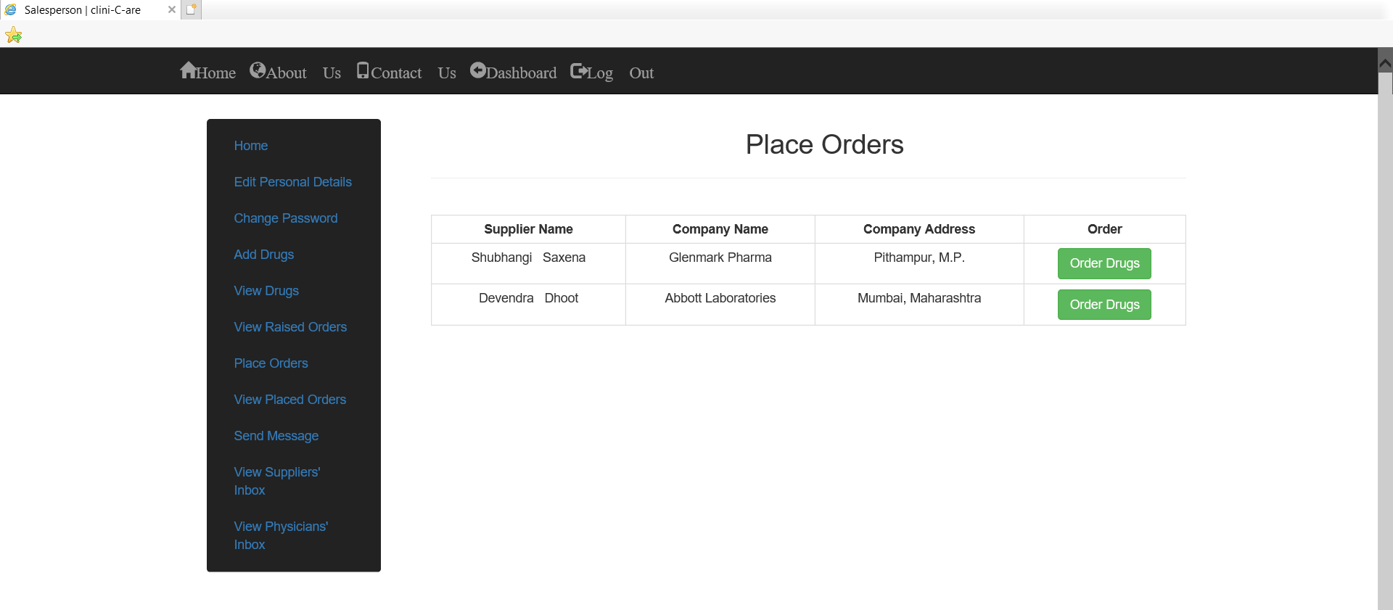
Snapshot of clini-C-are
Place Orders Page – Salesperson

Slide 40
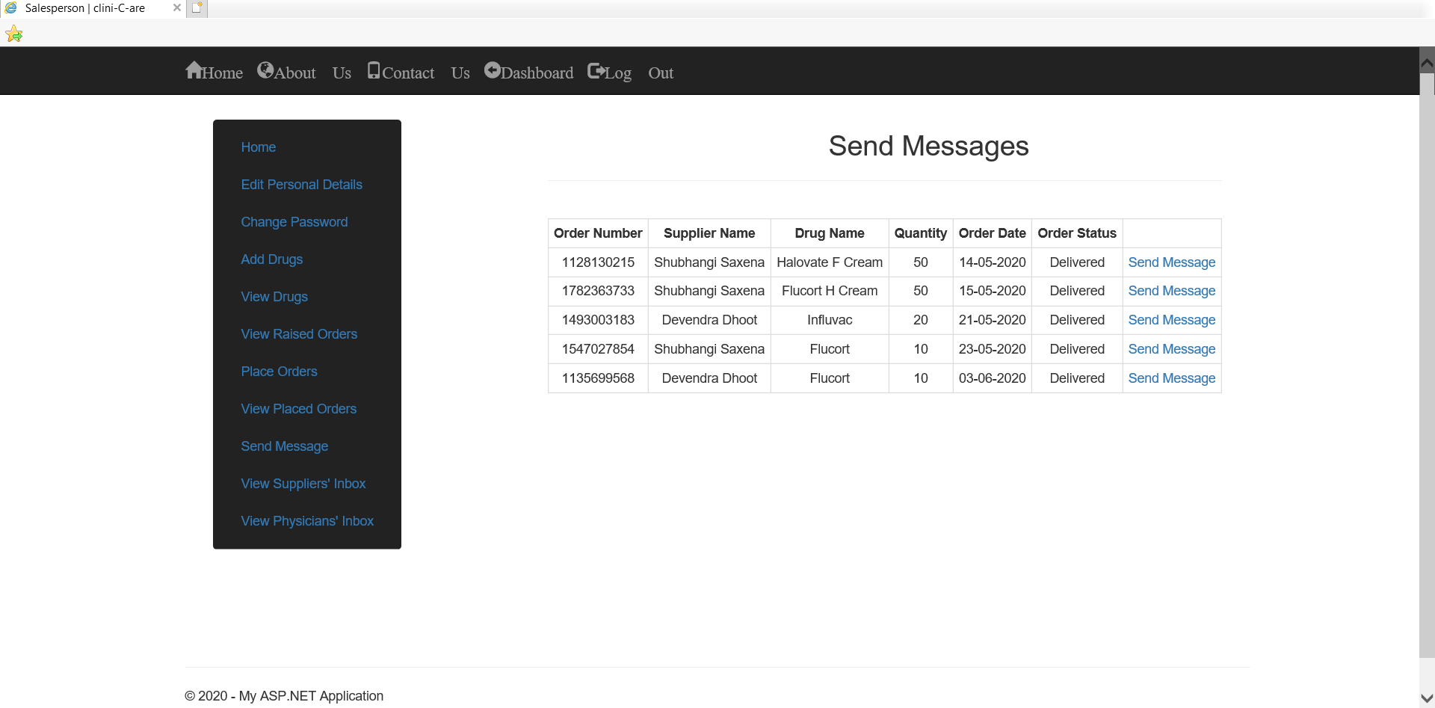
Snapshot of clini-C-are
Send Messages to Suppliers Page – Salesperson

Slide 41
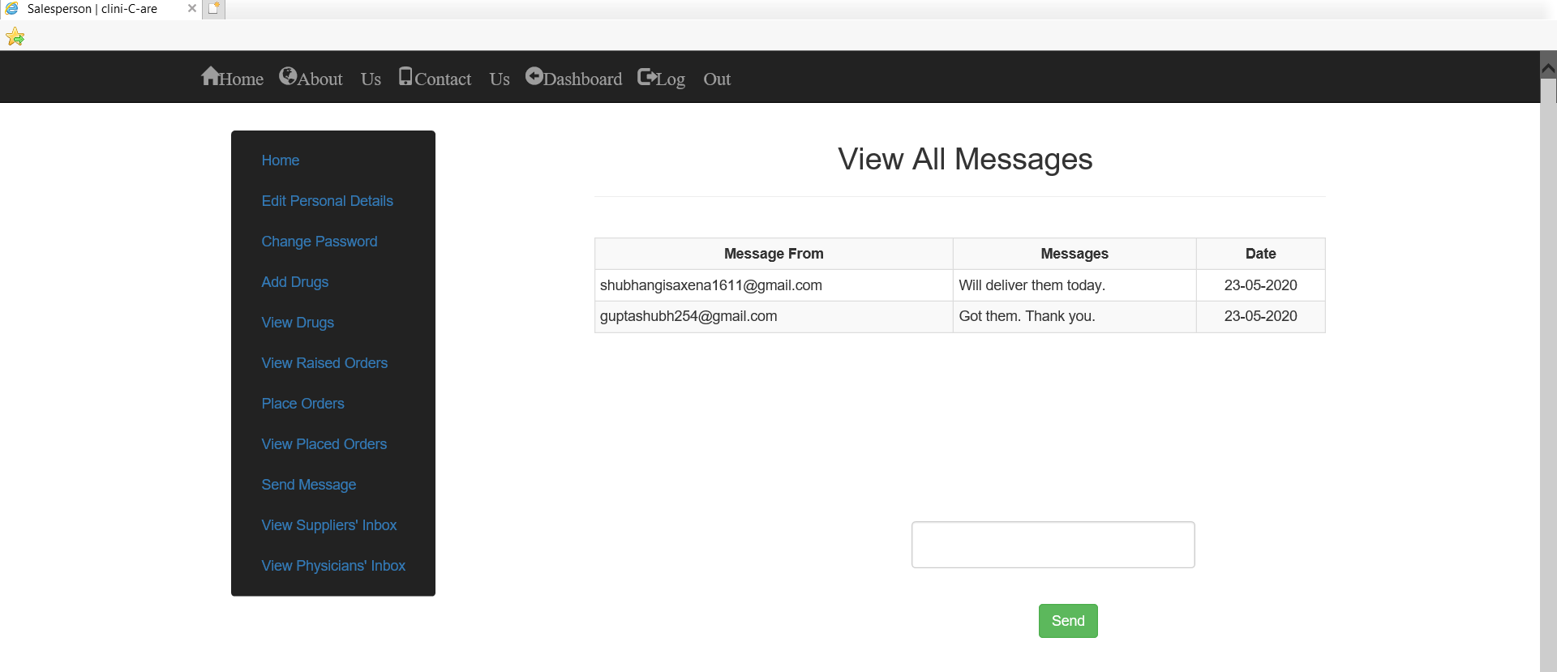
Snapshot of clini-C-are
Suppliers’ Inbox – Salesperson

Slide 42
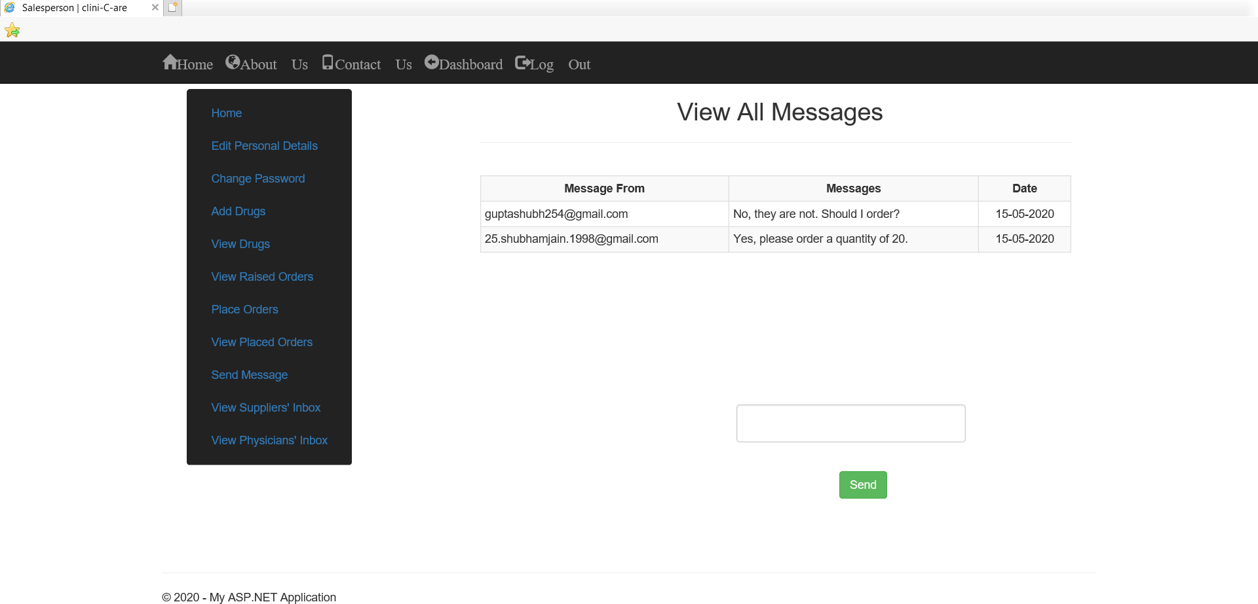
Snapshot of clini-C-are
Physicians’ Inbox – Salesperson

Slide 43
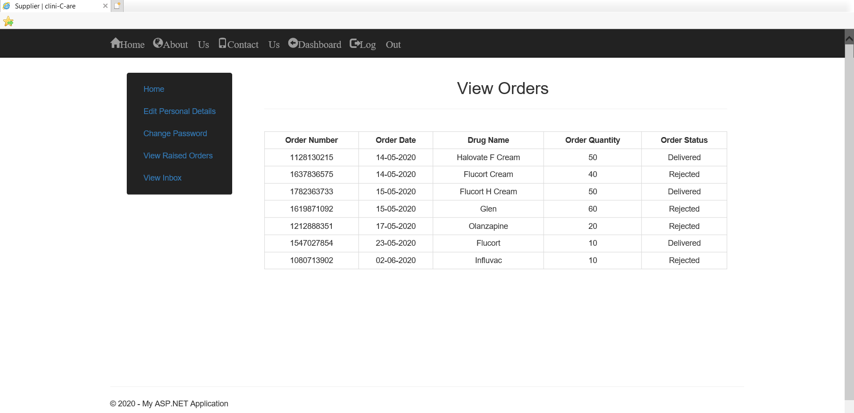
Snapshot of clini-C-are
View Orders Page – Supplier

Slide 44
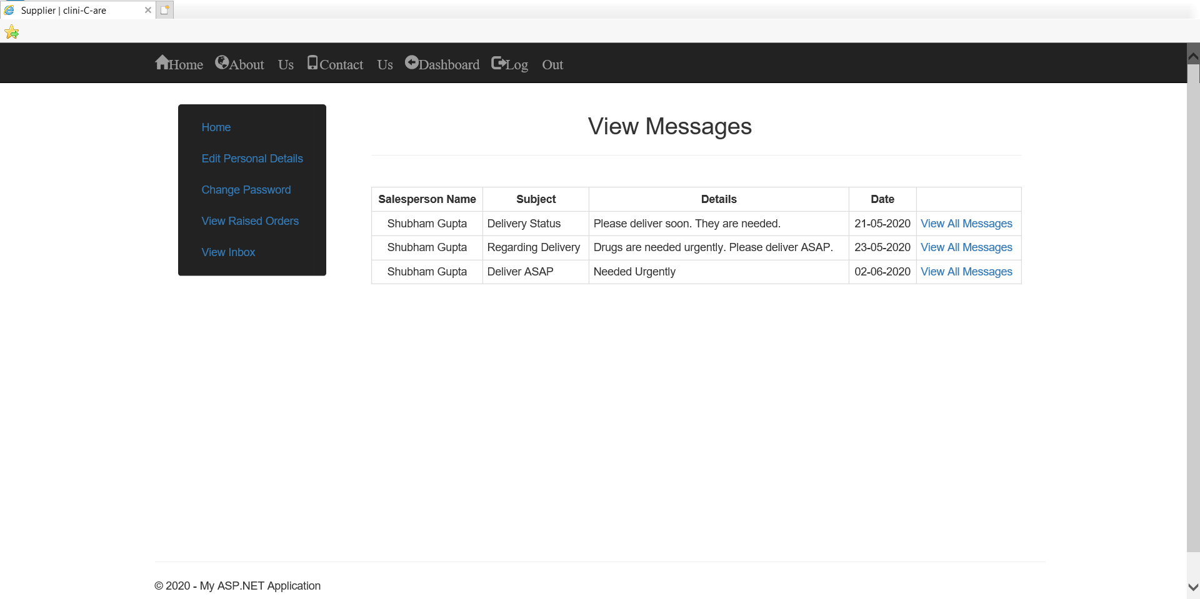
Snapshot of clini-C-are
View Messages Page – Supplier

Slide 45
Technologies Used
Visual Studio 2019
ASP.NET MVC Framework
Entity Framework
Microsoft SQL Server Management Studio
Front-End Technologies like HTML, CSS, Bootstrap, AJAX

Slide 46

The Future
What clini-C-are can be?
The current project lacks a payment API and thus, payment will have to be done in Cash. With the advent of digital India, online transactions are a must.
The filtering and search techniques have to be modified to accommodate for a larger system.
This application can be integrated with a video call application to provide online consultation.

Slide 47
So Far…
Got hands-on training on C# fundamentals, .NET Framework, LINQ, ADO.NET, Entity Framework, ASP.NET, MVC Framework.
Got an insight on SDLC, Agile SCRUM model, DevOps and its tools.
Provided an insight on how things moved in the professional software world.

Slide 48




Thank You!

